Slide 1

Security Shepherd
Gareth Dixon

Slide 2

Introduction
Gareth Dixon
Senior Test Analyst (Payroll) and also UKI Lead Security Champion at Sage
Worked in Product Engineering for 7 years
Increasingly involved in Software Security within last 2 years
Currently working towards security qualifications (CSSLP and Certified Pen Tester status)

Slide 3
Security Shepherd Event - Contents
Why have an event?
What do we need?
Stages:
Planning
Preparation
Execution
Review

Slide 4
Security Shepherd Event
Why?

Slide 5
Security Shepherd Event – Why?
Secure Software Development Lifecycle
Security Definition of Done – Code Quality
Secure@Sage
Learn security within teams
Security Objectives

Slide 6
Security Shepherd Event – Why?
People Development
Refresh or build understanding/skills in application security
Employ ‘Gamification of Learning’:
Powerful technique to increase knowledge
Leverage natural competiveness for motivation
Team dynamics mean the weaker members are supported by stronger members
Streets ahead of self study or classroom training in terms of engagement/outcome.

Slide 7
Security Shepherd Event – What are we going to use?
The OWASP Security Shepherd project is a web and mobile application security training platform. Created by Mark Denihan and Sean Duggan. Security Shepherd is a Flagship OWASP project.
OWASP Security Shepherd provides:
Teaching Tool for All Application Security
Web/Mobile Application Pen Testing Training
Safe Playground to Practise AppSec Techniques
Real Security Risk Examples

Slide 8

Security Shepherd Event – What does it use?

Slide 9
Security Shepherd Event – What do we want participants to do?
Complete as many challenges as possible
Learn as much as possible
Work together and support each other
Take what they have learned and apply it to Sage products/services
Socialise their experience of the event
Provide Feedback on the event to Security Champions
Have fun!

Slide 10
Security Shepherd Event
PLANNING

Slide 11
Security Shepherd Event – Planning
Who
What
When
Review
Support

Slide 12
Security Shepherd Event – Planning - Who
SSG (Service Security)
Security Champions Leads
Security Champions
Leadership
IT
Engineering Teams

Slide 13
Security Shepherd Event – Planning - What
Security Shepherd (where???)
Secure management buy in (who???)
Raise awareness (how???)
Individuals vs Teams (what’s the difference)
Prizes

Slide 14
Security Shepherd Event – Planning – When
How long is enough?
Options:
Hackathon type event (24 hour non stop)
Couple of days
A week
A month
Open, until there is a winner?
What will be the best for engagement? What about people on holiday etc?
What is the best for people to learn?

Slide 15
Security Shepherd Event – Planning - Review
Review everything
Don’t be afraid to change course
Speak to everyone you need to
Ask for their view
Explore the pros and cons of every decision
Gain agreement before moving forward

Slide 16
Security Shepherd Event – Planning - Support
Leaders
VP and Directors (budget and endorsement of event)
Senior Managers (to keep focus on the event with their teams, escalation routes)
Team leaders (raise in 121’s, discuss in context of objectives and goals)
IT
Advice/review on suitability of environments
Security
Planning, Environment config, Initial Comms, Participation and Presentation

Slide 17
Security Shepherd Event
PREPARATION

Slide 18
Security Shepherd Event - Preparation
Secure Leadership Support
Environment Set-up (Server and Client)
Testing
Design of event comms
Printing of materials/Fly-postering
Digital Comms (TV’s and internal Social media platforms)
Procurement
One week before distribute comms

Slide 19
Security Shepherd Event – Prep - Secure Leadership Support
Attend ELT sessions across locations
Explain What and Why
Cover goals and how we measure them
Be explicit about what we need from those in leadership roles
Keep the conversations going throughout the event

Slide 20
Security Shepherd Event – Prep – Environment Setup (Server)
Security Shepherd v3 deployed in Virtual machine hosted in Skytap (uses VMware)
Configured with public IP
Configured with self signed SSL cert
Thumbprint shared with participants
Allocated storage and processing resources with auto shutdown disabled
Templated in case of machine failure throughout the event
Set up in ‘Tournament Mode’
2 Admins set up
Landing page customized for the event

Slide 21
Security Shepherd Event - Prep – Environment Setup (Client)
Windows 10 64-bit virtual machine in Skytap (Security Shepherd Client)
The following intercepting proxies were installed:
OWASP ZAP
Portswigger Burpsuite (Free edition)
Telerik Fiddler
Shortcut added to desktop pointing to Security Shepherd Server

Slide 22
Security Shepherd Event - Testing
Test Accounts created on server. Completed basic tests of:
Access Server from client VM and from machines external to Skytap
Account creation (register)
Login
Complete basic challenge
Check hints
Leave Feedback
Scoreboard

Slide 23
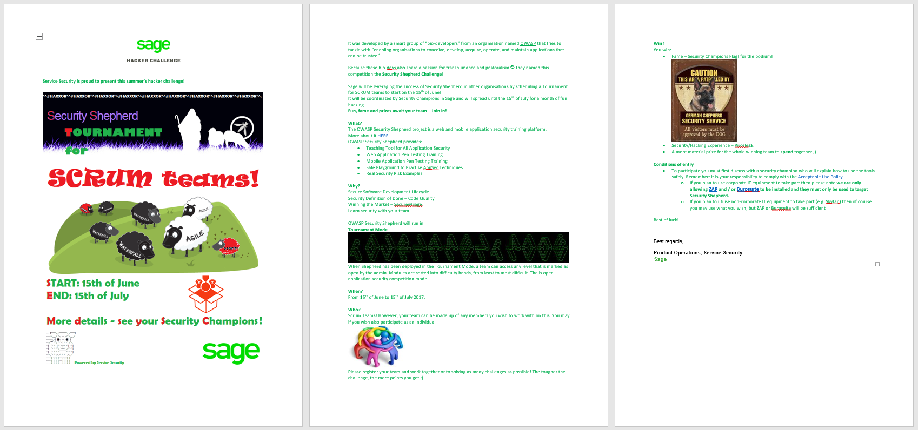
Security Shepherd Event - Design of event comms
Initial Comms

Slide 24
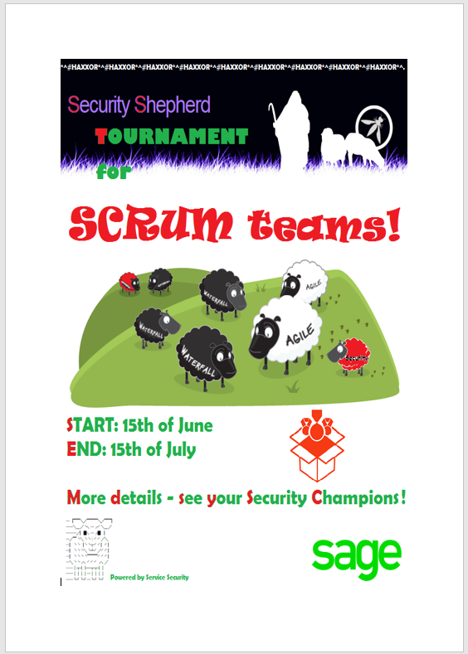
Security Shepherd Event - Design of event comms
Poster

Slide 25
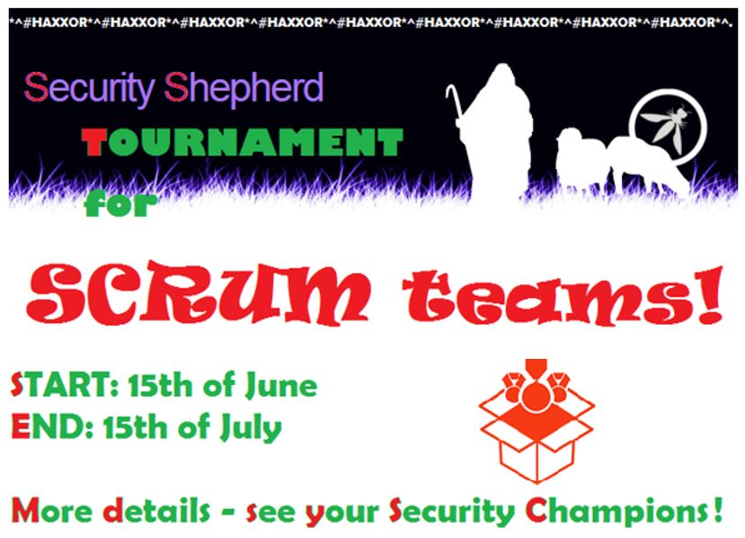
Security Shepherd Event - Design of event comms
TV

Slide 26
Security Shepherd Event - Printing of materials/Fly-postering
Printed just using office printers. No need to go to external printers
A3 and A4 size
Placed in:
Common areas/noticeboards
Office pillars
Doors
Hallways
Toilets

Slide 27
Security Shepherd Event - Digital Comms (TV’s and internal Social media platforms)
TV’s in Engineering areas
Internal comms - newsletter
Internal comms – TV broadcasts
Intranet
Security Portal
Internal Social media site/s
Internal collaboration tools

Slide 28
Security Shepherd Event – Procurement
Food – kick offs (cake and biscuits)
Prize/s (initially these weren’t defined but we knew we had budget)

Slide 29
Security Shepherd Event – Event Announced
Comms go out one week before the event.
Initial email from service security
Posters go up in planned locations
Security champions and leaders start drumming up interest in teams

Slide 30
Security Shepherd Event
EXECUTION

Slide 31
Security Shepherd Event - Execution
Registration
Event Kick Off’s
Team sessions
Regular comms
Evangelise with others
Finale
Presentation

Slide 32
Security Shepherd Event – Execution - Registration
Security champions collate details of those who want to participate within teams
They document registrations in a shared location for each area
Invite those registered to ‘Kick Off’ sessions (locally)

Slide 33
Security Shepherd Event – Execution – Event Kick Offs
Held in each location (NCL, MCR, DUB, WIN, LON)
Sometimes more than one in same location depending on numbers
All Kick Off’s followed the same script, same message.
Demo given (client and server)
Kick off document shared electronically with registrants at this point
Guidelines given on forming teams, working together and learning together.

Slide 34
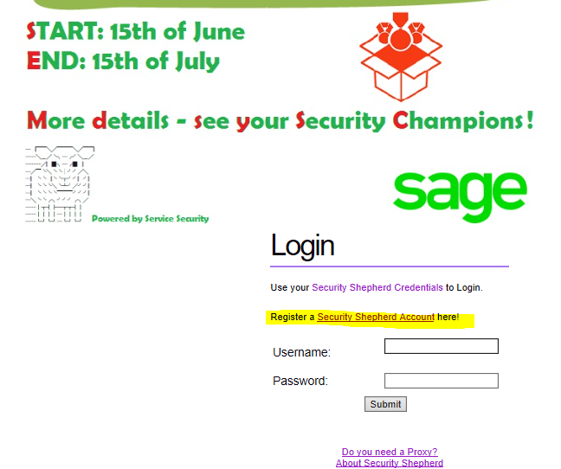
Security Shepherd Event – Execution – Event Kick Offs
Login page (customised):

Slide 35
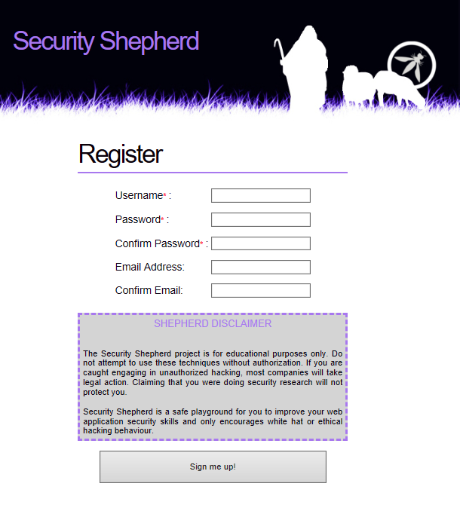
Security Shepherd Event – Execution – Event Kick Offs
Registration:

Slide 36
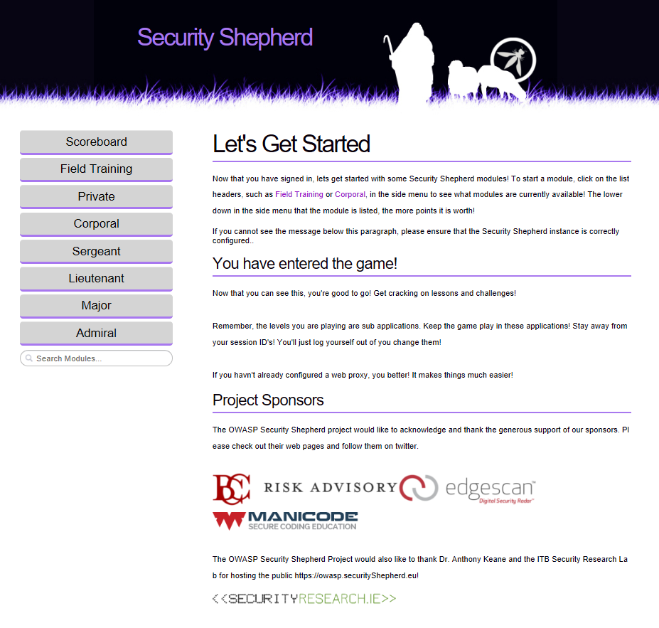
Security Shepherd Event – Execution – Event Kick Offs
Landing Page (logged in)

Slide 37
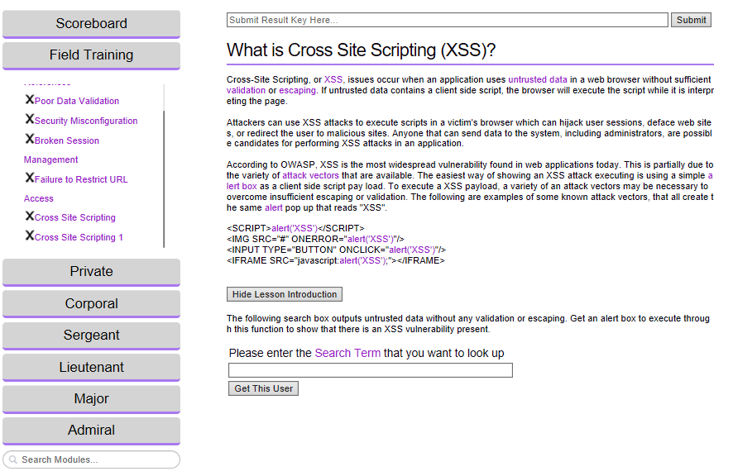
Security Shepherd Event – Execution – Event Kick Offs
Field Training:

Slide 38
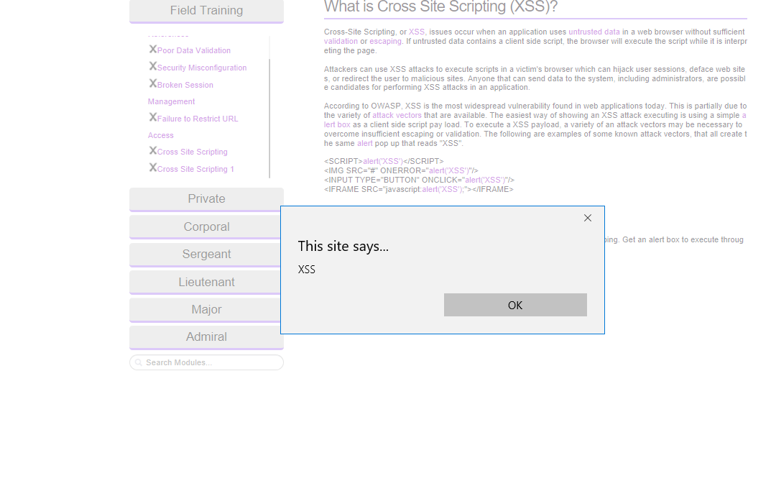
Security Shepherd Event – Execution – Event Kick Offs
Attempted XSS:

Slide 39
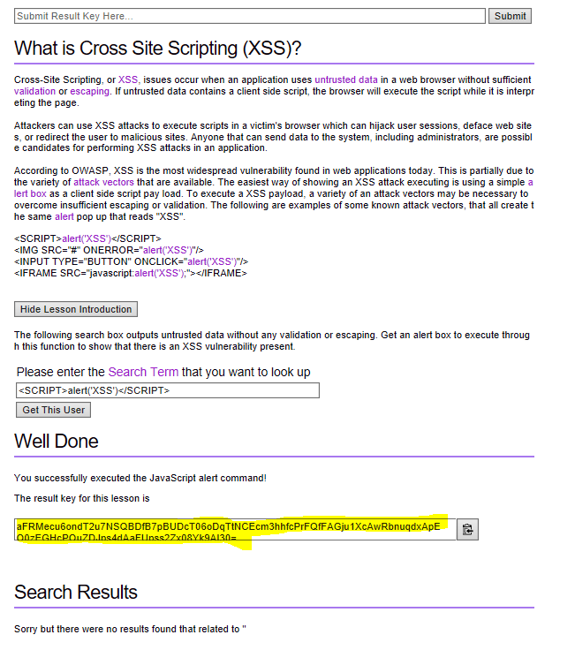
Security Shepherd Event – Execution – Event Kick Offs
Using Result Key:

Slide 40
Security Shepherd Event – Execution – Team sessions
Teams formed around this event and self organised
They held regular sessions to either tackle challenges or review solutions
Each team had a single shared login
Security Shepherd supports multiple logins with same credentials.

Slide 41
Security Shepherd Event – Execution – Evangelise with others
Security Champions continue to talk to teams about the event, those involved and those who are not.
Raise awareness in:
Team meetings
Daily Stand-ups
121’s
Open conversation in the office

Slide 42
Security Shepherd Event – Execution – Regular comms
Comms went out at least weekly
Usually more frequently on internal social media which has broad audience in UKI as well as across the globe
Posts included:
scoreboard as at that date/time
Upbeat narrative
Hypothetical questions on what would happen next
Details of next expected communication
Invitation for everyone to still get involved

Slide 43
Security Shepherd Event – Execution – Regular comms
Excerpt from Update 1 (text only):
Currently running in joint 3rd place we have Team MTD and DancingPigs on 499 points.
In 2nd place we currently have The Salty Pretzels on 770 points.
So at the end of the first week we have a clear front runner with HRPK1 on 1303 points!!
Product Engineering Director shared details of the event with EVP

Slide 44
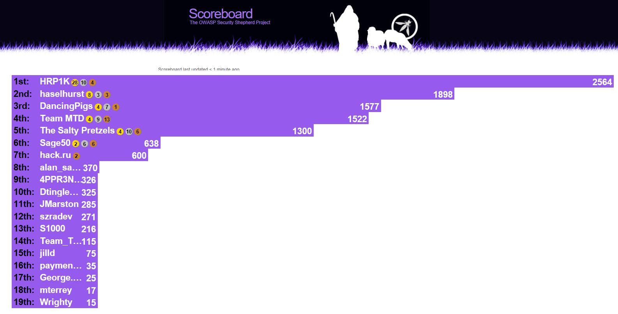
Security Shepherd Event – Execution – Regular comms
Update 2

Slide 45
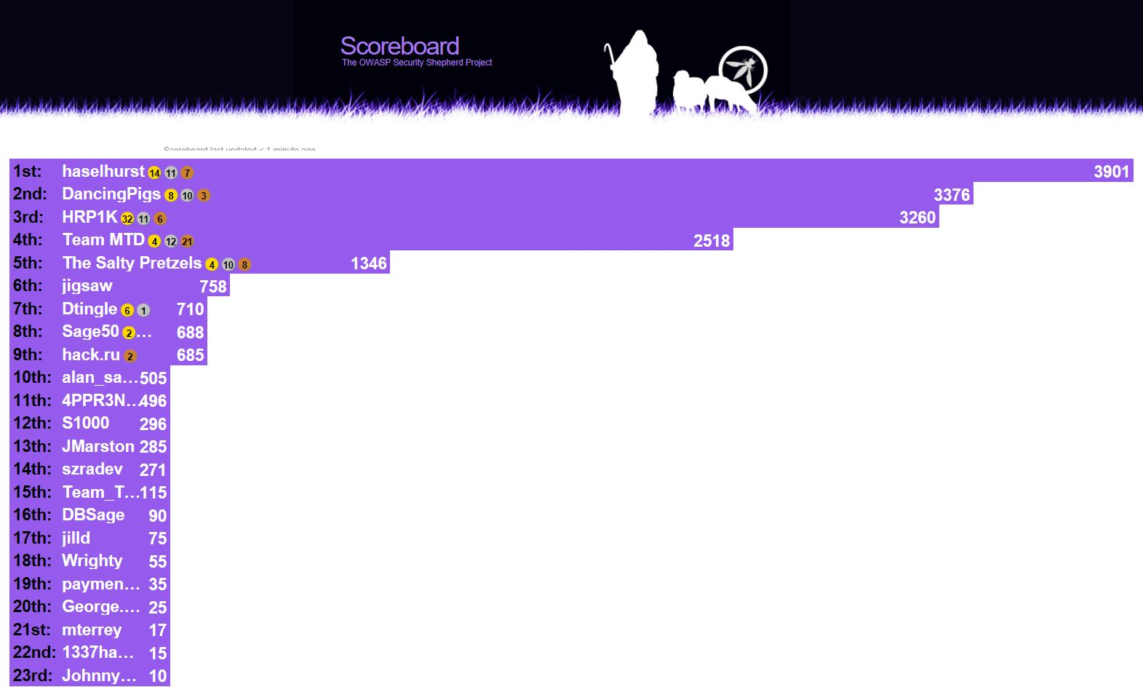
Security Shepherd Event – Execution – Regular comms
Update 3

Slide 46
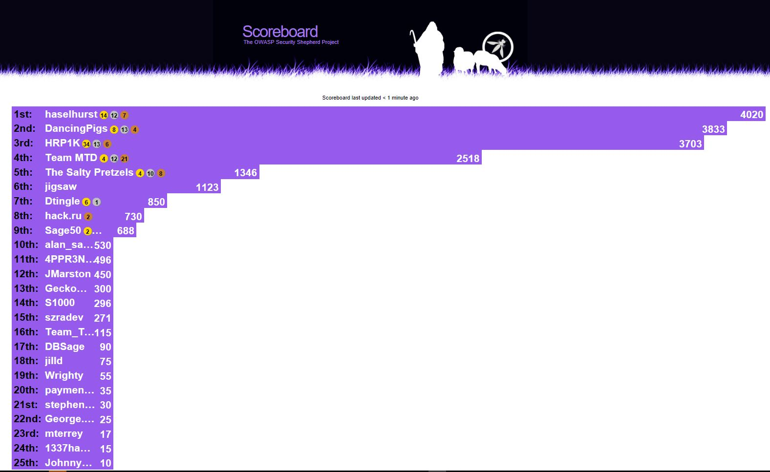
Security Shepherd Event – Execution – Regular comms
Update 4

Slide 47
Security Shepherd Event – Execution - Finale
Saturday 15th July
Event ended at midnight
Lead changed hands twice that day
Winner hit the top of the scoreboard at 7pm
Other teams had nothing left in the tank
Scoreboard imaged at midnight and verified

Slide 48
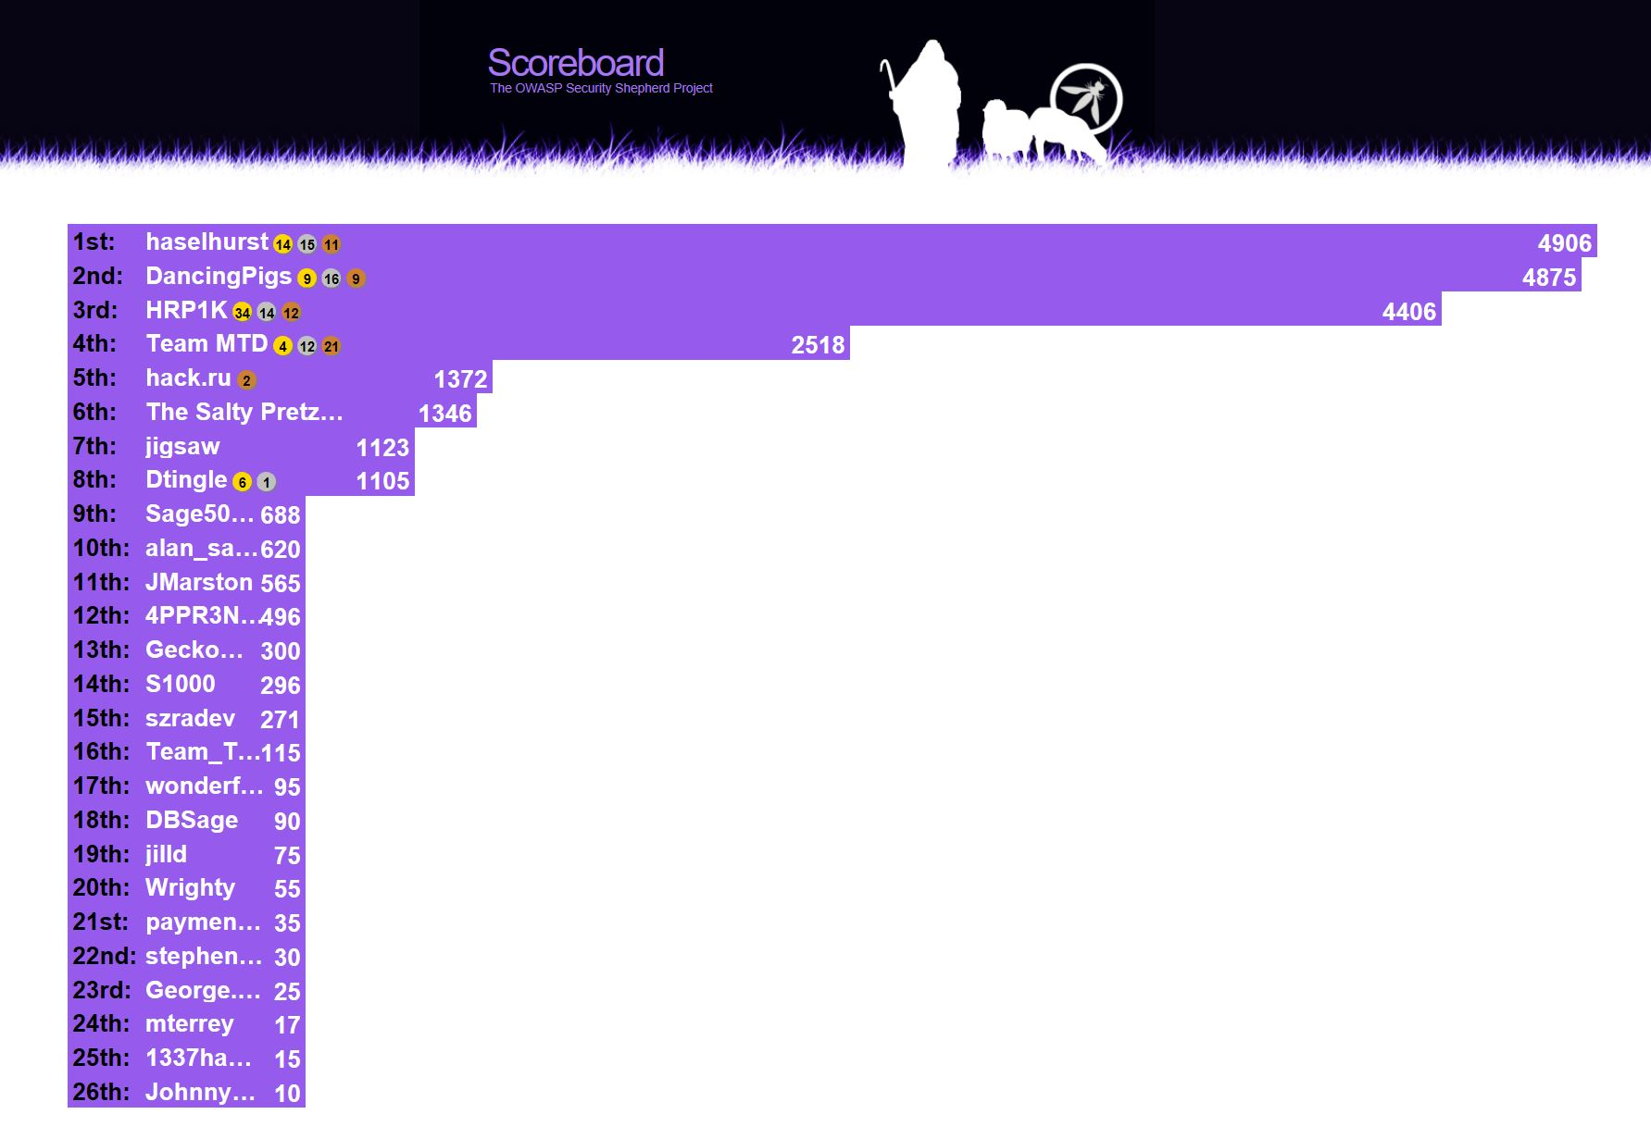
Security Shepherd Event – Execution – Final Scoreboard

Slide 49
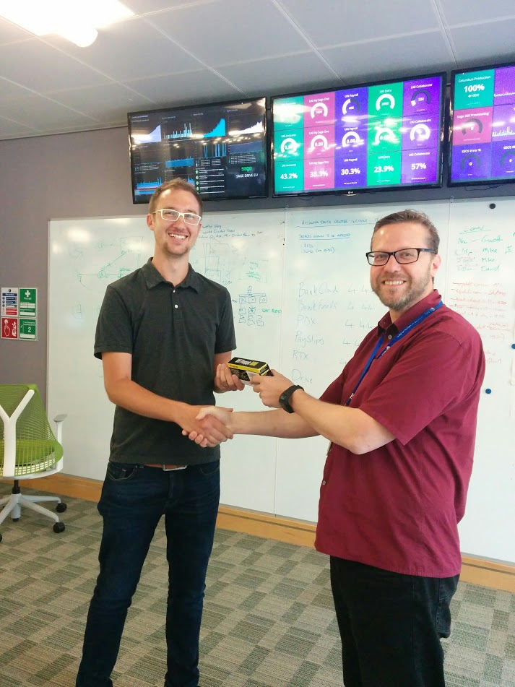
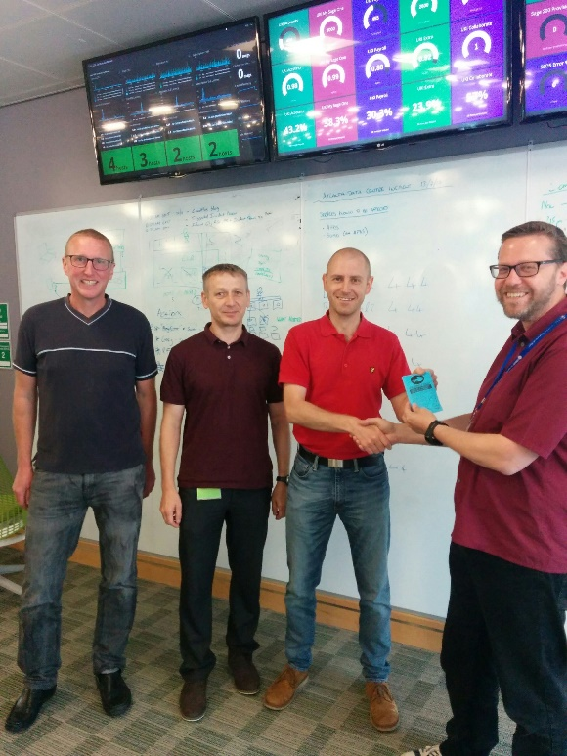
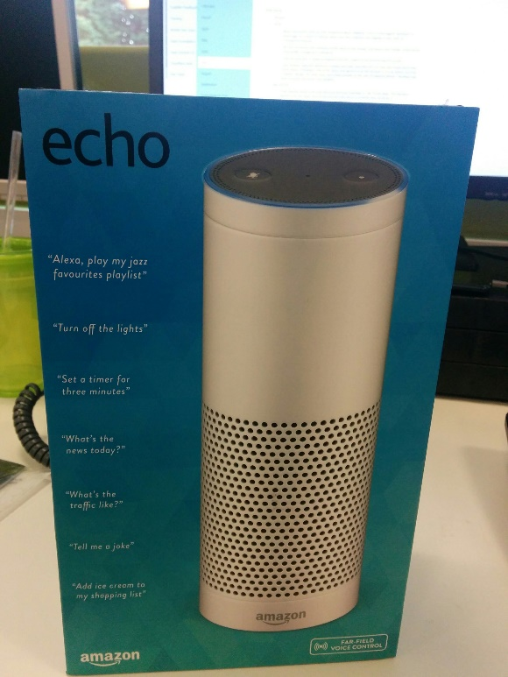
Security Shepherd Event – Execution - Presentation
From Mike Goodwin (VP of Service Security, Products)
1st 2nd 3rd

Slide 50
Security Shepherd Event – Execution – Final Credits circulated
Thanks to:
Players in final positions (26 teams or individuals)
Organisers:
Security Champions Leads Team
Senior Security Operations Manager
Lead Security Specialist
VP Service Security
Notes:
Security Champions Leads Team: (event organisation and planning, documentation, fly postering, kick offs and ‘in event’ comms)
Security Champions: participating in and evangelising the event in their areas
Senior Security Operations Manager: Setting up the Security Shepherd environment and planning assistance
Lead Security Specialist: event participation, planning assistance, initial comms, procuring the prizes and presentation.
VP Service Security: Supporting the event with budget for prizes and presentation for the winner.

Slide 51
Security Shepherd Event
REVIEW

Slide 52
Security Shepherd Event - Review
Stop
Start
Continue
Follow up – solution videos
Follow up – prize reviews

Slide 53
Security Shepherd Event - Review
Stop
The event was useful but we should not overdo them i.e. not more than 2 per year.
Get rid of the mobile challenges
Questions were displayed after solving a challenge seemed a bit pointless
Stop encouraging people to have shared logins. Better to have individual logins

Slide 54
Security Shepherd Event - Review
Start
Confirm how challenges are scored in advance
Duration of 48 hours instead of a month (so no issues trying to fit in the event)
Set fixed team sizes
Announce prizes up front, just to get more people motivated.
Have the advertising before kick-off explain the challenge a little more, the detail was hidden in tiny green text
Put the scoreboard on the big screens, give it a bit more ceremony
Ensure participants have Skytap registrations before

Slide 55
Security Shepherd Event - Review
Start
A ‘Highlights’ Session where some of the more interesting challenges are broken down and explained (not long, maybe even an optional attendance meeting)
Ensure the method of scoring is clear, we lost a lot of points and would probably have won otherwise
Engage the teams sooner
Have more team workshops or work in tasks in pairs, not individually
Prizes needed to be reviewed to ensure all team members are incentivised
Comms need to be reviewed so that we reach as many people as possible
Provide a guide on the likely time needed to complete an exercise / section

Slide 56
Security Shepherd Event - Review
Start
Assign exercises to individuals who present back – may be run as a mini-sprint with a backlog of items from people to present back at a scheduled meeting.
Try to ensure roughly equal share of exercises across people participating
Assign somebody in each team to take notes, screen shot etc. of the solution so that we can present this at the end.
Some of the teams lost interest because of time so we could offer some better incentives to finish the course.
Security Champion challenge – gather points for individuals

Slide 57
Security Shepherd Event - Review
Continue:
More appreciated than the mandatory security training (event, then training). Sessions were educational.
Kick off Events with Cakes and Biscuits
Format was good, good to work in teams, it was good fun
Platform and tools were good
Scoreboard
Leave environment available for learning
Surprises, Rob Fewster joining the tournament later on, not knowing what comes next

Slide 58
Security Shepherd Event - Review
Continue:
Teams sessions were productive and informative and I enjoyed doing it. It provided a review of how much I had picked up from the mandatory security training modules.
Share the actual driving of the exercise in each team, possibly sharing the exercises out to individuals and they then come back with a solution to present back to the team.
I felt it was good as a team building exercise/activity. It also provided insight into the tools/techniques that we used.
Not sure if I would have been able to tackle any of this on my own. More hints for the really complex tasks would have helped.
Found it interesting but would have struggled to complete all the challenges on my own

Slide 59
Security Shepherd Event – Follow up
Follow up – solutions videos and prize reviews
Ask 1st , 2nd and 3rd place team members to create:
Solutions videos to share via internal security portal:
Recorded via Skype for Business
One video per challenge type covering all solutions
10 min max per challenge type (e.g. SQL injection)
Review videos of prizes in a security context. Again, share via internal security portal

Slide 60
Questions?

Slide 61
Thank You for listening
Gareth Dixon

Slide 62


